Slide 1
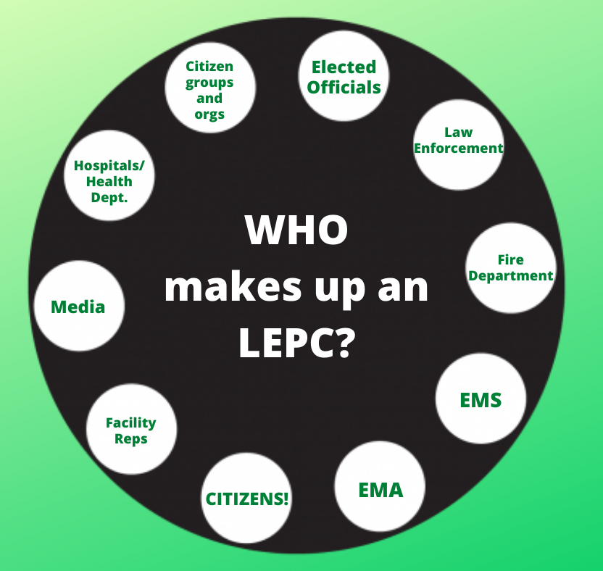
Welcome to LEPC/TEPC 101 Please enter your Name, Organization and LEPC or Tribe you’re affiliated with in the chat.
Notes:
Welcome, we will get started in a few minutes. Please enter your Name and LEPC or Tribe you’re associated with in the chat. We would also like to list the organization type you represent. For example, emergency management, print media or local health department. This will be an interactive discussion and we will encourage participation. However, please keep your camera off and microphone muted until it’s time to contribute.

Slide 2
Washington State LEPC/TEPC 101
Notes:
Welcome. This presentation, entitled Washington State Local Emergency Planning Committee (LEPC) / Tribal Emergency Planning Committee (TEPC) 101, is intended for LEPC, TEPC or Washington State Emergency Response Commission (SERC) members who would like to gain an understanding of the roles and responsibilities in meeting the intent of the Emergency Planning and Community Right-to-know Act (EPCRA). It is presented by SERC support staff and intended to precede another presentation Entitled, Washington State LEPC/TEPC 102, that will dive more into the administrative aspects of meeting EPCRA requirements.
Please keep your microphone muted and video turned off unless you are speaking. Feel free to use the raise hand function or chat function at any time during the presentation to ask questions and make comments. This is an interactive presentation, and your questions and comments are welcome. Please enter your name, LEPC or Tribe you are affiliated with in the chat. Please be aware that this presentation will be recorded for future use and will be made available. Also, after we finish today, please fill out the survey to help improve future presentations.
Optional facilitator possible engagement questions to participants:
-Using the raise hand function, please raise your hand if you are an LEPC Community Coordinator.

Slide 3
Agenda
What is EPCRA?
Roles and Responsibilities of LEPCs and TEPCs.
Reporting Basics and Resources.
LEPC/TEPC Exercises.
LEPC/TEPC Training Program.
Measuring Success.
LEPC/TEPC Planning Process.
Notes:
The agenda for today will cover an overview of EPCRA, the roles and responsibilities of LEPCs and TEPCs and go over EPCRA Reporting. The Presentation will also cover the members role in planning, participating in exercises and what is expected from a training program. During this presentation, EPCRA reporting requirements will be covered extensively while more in-depth administrative functions of running an LEPC or TEPC will be covered in Washington State LEPC/TEPC 102. The primary audience for the 102 presentation is Community Coordinators and officers but all are welcome to attend that presentation.
I will now turn this presentation over to (ADD Name) who will go over What is EPCRA.

Slide 4
What is EPCRA?
Emergency Planning
and Community Right-to-Know Act
Notes:
EPCRA is a federal law, and its goal is to protect public health, safety, and the environment from chemical hazards. ​
​
It does this through reports and notifications that provide information used to help communities plan and prepare for chemical emergencies. EPCRA data are used by emergency planners and first responders to plan, prepare, and respond to emergencies. It also supports decision-making by state and tribal governments, local agencies, and the public.

Slide 5
Bhophal, India 1984
Notes:
In December 1984, an industrial accident in Bhopal, India released methyl isocyanate, a chemical used to make pesticides, plastics and other products. The accident killed thousands and injured many more.
As you can see by the cover of TIME magazine, the disaster made headlines around the world. The company responsible for the release was Union Carbide, a U.S. company. Some in the United States believed that although the accident was a tragedy, it had occurred in a country with weaker environmental laws and safety oversight, insulating the U.S. from such a disaster.
Optional facilitator possible engagement questions to participants:
-What do you think the long-term consequences of a disaster like this would be for your jurisdiction? (first responders, do you know what facilities in your communities pose risks? Facilities, what happens to you and the community around you? Ems, What keeps you up at night?)

Slide 6
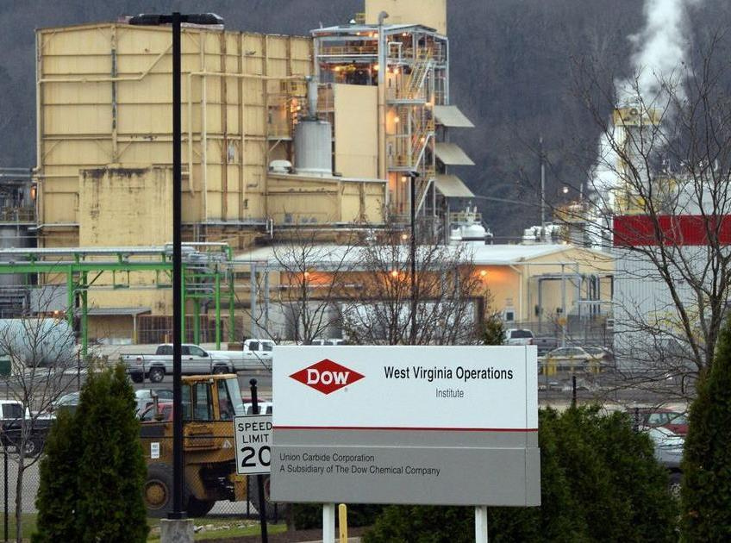
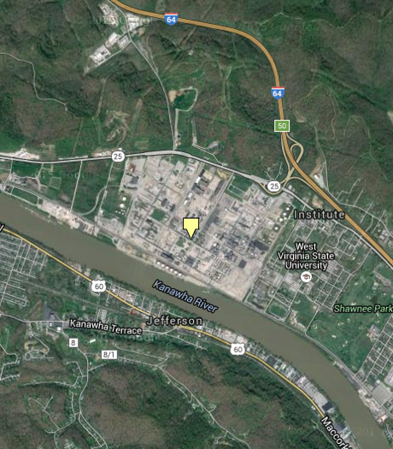
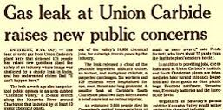
Institute, West Virginia
Notes:
Less than a year later, at a Union Carbide plant (now Dow) in Institute, West Virginia, a chemical leak injured 6 workers and exposed more than a hundred residents, sending 28 people to the hospital for eye, throat, and lung irritation. The chemical released was not methyl isocyanate, but it was present at the plant. This particular plant was the only place in the U.S. at the time where methyl isocyanate was manufactured and stockpiled, the same chemical that was released in Bhopal.
Institute is a town of 3,100 people that largely surrounds West Virginia State College. It’s about 10 miles north of Charleston. You can see by the photo on the right, it’s also near a river and an interstate highway. This event could have been much worse.
This “close call” event led many to question whether the industrial accident that occurred in Bhopal could happen here in the United States. The public demanded to know what was in their own backyards, and questioned whether they could be impacted by a chemical release from an industrial facility. First responders also needed to know what chemicals these facilities used and stored in the event of a spill or other disaster.
Reminder to facilitator to ask participants if they have questions:

Slide 7
Federal Response
CERCLA was amended in 1986 when the SARA* is signed into federal law
*Superfund Amendments and Reauthorization Act
Title III of SARA is EPCRA
Emergency Planning and
Community
Right-to-Know Act
CERCLA – Comprehensive Environmental Response, Compensation, and Liability Act of 1980 (a.k.a. “Superfund”) https://www.govinfo.gov/content/pkg/USCODE-2011-title42/html/USCODE-2011-title42-chap103.htm
Notes:
As a result of these incidents, the Comprehensive Environmental Responsibility and Liability Act (CERCLA) was amended in 1986 with the Superfund Amendments and Reauthorization Act (SARA) and signed into federal law. Title III of SARA is EPCRA, the Emergency Planning and Community Right-to-Know Act.

Slide 8
What is EPCRA?
Businesses report information about hazardous chemicals.
The reporting requirements depend on the type and quantity of chemicals stored or released.
It protects first responders and communities—they can plan and prepare for emergencies and know “what’s in our neighborhood.”
Notes:
As the name implies, EPCRA has two main components: Emergency Planning and Community Right-to-Know
The goal of EPCRA is to protect public health, safety and the environment from chemical hazards.
To meet this goal, EPCRA requires federal and state governments, tribal nations, local agencies, and industries to work together on emergency planning and preparedness.

Slide 9
Washington State Emergency Response Commission WAC 118-40
https://apps.leg.wa.gov/wac/default.aspx?cite=118-40
Notes:
With the creation of EPCRA in federal law, states now needed to find a way to implement EPCRA manage mandatory reports. This federal mandate is unfunded, meaning the states are not given funds to accomplish these requirements.
In Washington State, Governor Booth Gardner established the Washington State Emergency Response Commission, or SERC, in April 1987 under WAC 118-40. SERC membership includes state agencies, private industry, emergency planners and first responders, and others.
Three agencies - Dept. of Ecology, Washington State Patrol, and the Emergency Management Division serve as advisors to the SERC and have specific responsibilities under these regulations.

Slide 10
Ecology’s Responsibilities Under WAC 118-40
Spill Prevention, Preparedness, and Response Program.
EPCRA Community Right-to-Know.
Notes:
For the Department of Ecology, the Spills Program and the Hazardous Waste and Toxics Reduction Program carry out specific responsibilities outlined in WAC 118-40.
The Spills program serves as advisor to SERC on:
Emergency spill response and environmental restoration issues
Emergency responder equipment and training needs at the state and local levels.
On-scene spill response and environmental needs at the state and local levels.
The Hazardous Waste and Toxics Reduction Program houses the EPCRA program. EPCRA staff serve as advisor to the SERC on:
Community right-to-know issues, and
Developing, implementing, and maintaining an EPCRA CRTK Program. This includes data management of reports, technical assistance to businesses, and outreach to businesses and the public about EPCRA.

Slide 11
Washington State Patrol Responsibilities Under WAC 118-40
Emergency response and coordination of on-scene activities on state and interstate highways as the incident command agency.
Provide first responder training.
Advisor for emergency responder equipment and training needs at the state and local levels.
This Photo by Unknown Author is licensed under CC BY-NC-ND
Notes:
The Washington State Patrol serves as advisor to SERC on:
Emergency response and coordination of on-scene activities on state and interstate highways and other areas where it has been designated as the incident command agency.
Provide first responder training and maintain related records for state hazardous materials training as authorized through Section 305 of EPCRA.
Serve as advisor for emergency responder equipment and training needs at the state and local levels.

Slide 12
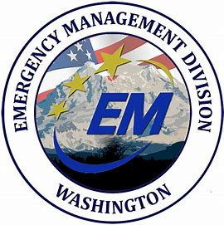
EMD’s Responsibilities Under WAC 118-40
Planning guidance and repository
Non-First Responder Training
Administrative Support
Managing HMEP Grant
Reporting to the Alert and Warning Center
Chapter 118-40 WAC:
Notes:
Under Washington Administrative code 118-40, EMD has 10 specific requirements. These requirements pertain to providing planning guidance and serving as a repository for plans, providing non-first responder training, providing administrative support for the SERC, managing the HMEP grant and managing hazardous material release reports in the Emergency Management Division Alert and Warning Center. The link at the bottom of this slide will take you to the full code describing all state and local responsibilities under EPCRA.
Optional facilitator possible engagement questions to participants:
Any questions about the intent of EPCRA or the states' role?

Slide 13
Washington State SERC Basics
Section 301(a) to (c) describes SERCs’ responsibilities. While not specifically stated in the statute, Tribes have the same responsibilities as SERCs.
The SERC exist to Support LEPCs and tribes.
Staff from multiple agencies support the SERC.
This commission is responsible for establishing local emergency planning districts.
The SERC meets quarterly.
Support includes recourses and hosting training events for LEPCs and Tribes.
SERC Membership – State Emergency Response Commission - Washington State Department of Ecology
Meeting Information / LEPC toolbox – State Emergency Response Commission (SERC) | Washington State Military Department, Citizens Serving Citizens with Pride & Tradition
SERC Training Calendar - WA EMD (learningstream.com)
13
Notes:
The SERC exists to support LEPC’s, and tribes meet EPCRA requirements. Staff from multiple state agencies support the SERC. SERC membership includes tribes, local and state representatives, federal partners, and private industry. One of the Commissions primary duties is to establish local emergency planning districts. There are currently 43 Districts, and the SERC has the authority to change these Districts at any time. This organization meets four times a year, two times in person and two times via Microsoft Teams. The SERC host three major events a year funded in whole or part by the HMEP Grant. This includes a LEPC/Tribal Conference and workshops on each side of the state. Resources, such as templates and links to training are kept in the LEPC Online Toolbox.
Please see the Department of Ecology website for a current list of SERC members and The Washington State Military Department website for information on meetings and access to the toolbox. SERC Events are also listed on the SERC Training calendar.
Reminder to facilitator to ask participants if they have questions:
For our next Section (Add Name) will go over the Role and Responsibilities of LEPCs and TEPCs

Slide 14
Roles and Responsibilities of the LEPCs and TEPCs
14
Notes:
In this next Section, we are going to cover the roles and responsibilities of a LEPC or TEPC.

Slide 15
Per the WAC and EPCRA: What is an LEPC?
LEPCS are community-based organizations that assist in preparing for emergencies, particularly those concerning hazardous materials.
Under EPCRA, LEPCs must:
Develop an emergency response plan.
Review the plan at least annually.
Provide information about hazardous materials in the community to citizens.
Plans are developed by LEPCs with stakeholder participation.
The LEPC membership must include (at a minimum):
Elected state and local officials.
Police, fire service, civil defense, and public health professionals.
Environment, transportation, and hospital officials.
Facility representatives.
Representatives from community groups and the media.
Notes:
LEPCs exist to share information and better prepare their communities for a hazardous material incident. They do this by meeting the intent of EPCRA. In Washington State we encourage LEPCs to practice all-hazards emergency management and LEPCs may have a membership broader than the requirements in EPCRA. At a minimum LEPC membership needs to include the following representation:
Elected state and local officials
Police, fire service, civil defense, and public health professionals
Environment, transportation, and hospital officials
Facility representatives
Representatives from community groups and the print and broadcast media
In Washington State each LEPC has an appointed Local Emergency Coordinator. This role is filled by an employee of the local jurisdiction’s Emergency Management office. The Local Emergency Coordinators is a contact for the LEPC and ensures the requirements of EPCRA are met. In most cases this person has many roles in their emergency management position.
Often the burden of finding appropriate member ship for LEPCS is placed on the Community Coordinator. Any member of the LEPC can help find and maintain membership. For example: If you LEPC has not had anyone from Print and broadcast Media attending meetings and some one from a local paper attends a meeting, make them feel welcome and let them know they would add value to the LEPC by sharing valuable information with the public even before any incident occurs.

Slide 16
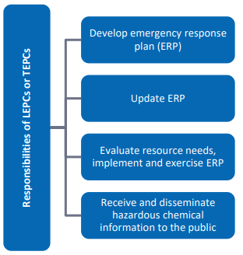
Responsibilities of an LEPC or TEPC
Notes:
Before we start discussing the responsibilities of an LEPC or TEPC, It’s important to note that LEPCs have a lot of responsibilities and limited resources. Please keep in mind that your Community Coordinator may have multiple duties in their role in Emergency Management and will not have the time or specific expertise to do all the tasks an LEPC requires. During this presentation, please think about what knowledge, skills, and resources you bring to your LEPC and how you can contribute to protecting your community. The most successful LEPCs in Washington have equal engagement among members and share the burden of tasks.
The concept of what an LEPC or TEPC should do is simple. However, when you think about the list of task, this can be a bit intimidating. If you are reenergizing your LEPC, please start small and know you don’t have to do everything at once.
Task Include:
• Conduct regular meetings to address all pertinent issues.
• Develop and maintain an inventory of known hazardous chemicals.
• Develop and update a hazard/risk analysis.
• Develop and periodically update emergency response procedures for off-site emergency response personnel.
• Identify private/public sector resources available to deal with hazardous chemical emergencies.
• Review, process and respond to requests from the public for pertinent information.
• Review, maintain and process all appropriate reports and records as required by law.
• Develop and periodically update emergency warning procedures and evacuation plans.
• Coordinate training programs on hazardous chemical safety and emergency response procedures.
• Coordinate emergency response exercises.
• Provide expertise and compliance assistance to industries and businesses upon request.
• Educate citizens in the community on what to do during an emergency.
• Receive, maintain and disseminate emerging legislation relating to hazardous chemicals.
Reminder to facilitator to ask participants if they have questions:

Slide 17
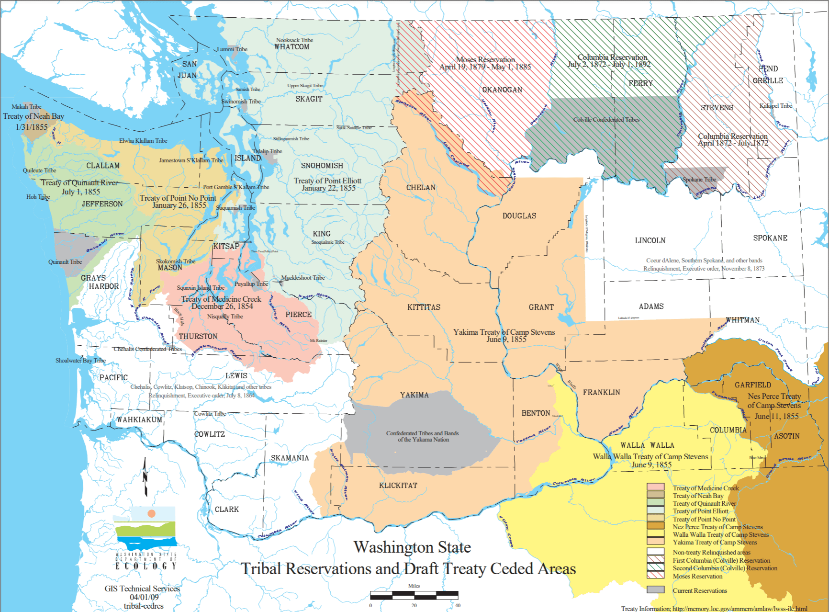
Tribal and Nation Partners
[55 Federal Register (FR) 30641; July 26, 1990]
Notes:
According to the Environment Protection Agency (EPA), for facilities located in on tribal land, the chief executive officer of the tribe is responsible for appointment of a Tribal Emergency Response Commission (TERC). A Tribal Emergency Response Commission (TERC) has similar responsibilities as a State Emergency Response Commission (SERC). Tribes may enter into a cooperative agreements with other tribes, or with the state(s) within which its lands are located to achieve a workable EPCRA program. Tribes that have entered into cooperative agreements should submit a copy of the signed agreement to the EPA Regional office for their location. This is per 55 Federal Register FR 30641 as of July 26, 1990. A link is located on this slide.
For the purpose of this presentation, we are referring to Washington State tribal and Nations partners as Tribal Emergency Planning Committees (TEPCs) because this is the current terminology used during national presentations and in EPA Documents. It is up to the Tribal or Nation Partners to determine how they meet EPCRA. to In Washington State all the support and resources available to LEPCs are also available to TEPCs. We highly encourage our LEPC to work closely with the Tribes and Nation Partners.
Reminder to facilitator to ask participants if they have questions:
I will now turn this presentation over to (Add Name) who will go over EPCRA Reporting.

Slide 18
Reporting Basics
Notes:
As mentioned, EPCRA is a federal law, and its goal is to protect public health, safety, and the environment from chemical hazards. It does this through reports and notifications that provide information used to help communities plan and prepare for chemical emergencies.

Slide 19
EPCRA Reports
Emergency Planning Notification
Section 302
Emergency Release Notifications
Section 304
Hazardous Chemical Notification (SDS)
Section 311
Hazardous Chemical Inventory Reporting (Tier Two)
Section 312
Toxics Release Inventory (TRI)
Section 313
Notes:
These are EPCRA’s key reports. These reports provide information that support:
Emergency planning and notification.
Notification of chemical releases that are accidental and that can expose neighboring businesses and the community.
Identification of chemical hazards present at a business.
And, in the case of the Toxics Release Inventory, or TRI, identification of toxic chemicals that may be released during the year, both as accidental releases and release that occur as part of normal business operations. TRI data show chemical releases to air, land, and water and also how chemical waste is managed or disposed.
The Dept. Of Ecology manages all of these reports on behalf of the SERC.

Slide 20
EPCRA Reports
d
Notifications:
Hazardous Chemical (SDS)
Section 311
Emergency Planning
Section 302
Emergency Release
Section 304
Annual Reports:
Hazardous Chemical Inventory (Tier Two)
Section 312
Toxics Release Inventory (TRI)
Section 313
Notes:
One way to think about these reports is by category, either as one-time notification or an annual report.
For example, under Section 311, businesses must notify the SERC (or Tribal Emergency Response Commision, if the business is on tribal lands), their LEPC or tribal equivalent, and their fire department within 90 days when a chemical that meets the reporting threshold is first brought on site. If that chemical is also an extremely hazardous substance, or EHS, that business has the additional responsibility, under Section 302, to notify within 60 days who their facility emergency coordinator is.
Under Section 304, businesses must notify if a chemical is released that could go beyond their facility boundaries and expose others.
There are two main annual reports – the Tier Two, due March 1 and the Toxics Release Inventory, or TRI report, due July 1. The Tier Two provides information about the quantity, types, and hazards of chemicals that businesses have or store on site. This information is used primarily for emergency planning and by first responders when responding to an emergency, such as a fire.
The TRI report is due July 1, and it provides information about chemicals a business uses and how these chemicals might be released to air, land and water, both as accidental releases and releases that occur as part of normal business operations. TRI also tells us how facilities are managing these chemicals through recycling, energy recovery, and treatment, or if they are transferring these chemicals off site for someone else to dispose or manage.

Slide 21
Who must report Tier Two? EPCRA 312
Any facility that has a chemical or product that requires an SDS.
AND
The hazardous substance meets or exceeds the reportable threshold at any time.
10,000 pounds.
EHS have lower thresholds.
https://www.osha.gov/laws-regs/regulations/standardnumber/1910/1910.1200
Notes:
Next, I'd like to go into more detail about the annual Tier Two report. A business is required to submit an annual Tier Two report if they have a chemical or product that requires an Safety Data Sheet, or SDS (meaning, it contains a hazardous substance under OSHA's Hazardous Communication Standard) and they have quantities that meet the reporting threshold. For most chemicals or products, the threshold is 10,000 pounds. For some chemicals, considered to be extremely hazardous substances, or EHS, the threshold is lower. https://www.osha.gov/laws-regs/regulations/standardnumber/1910/1910.1200

Slide 22
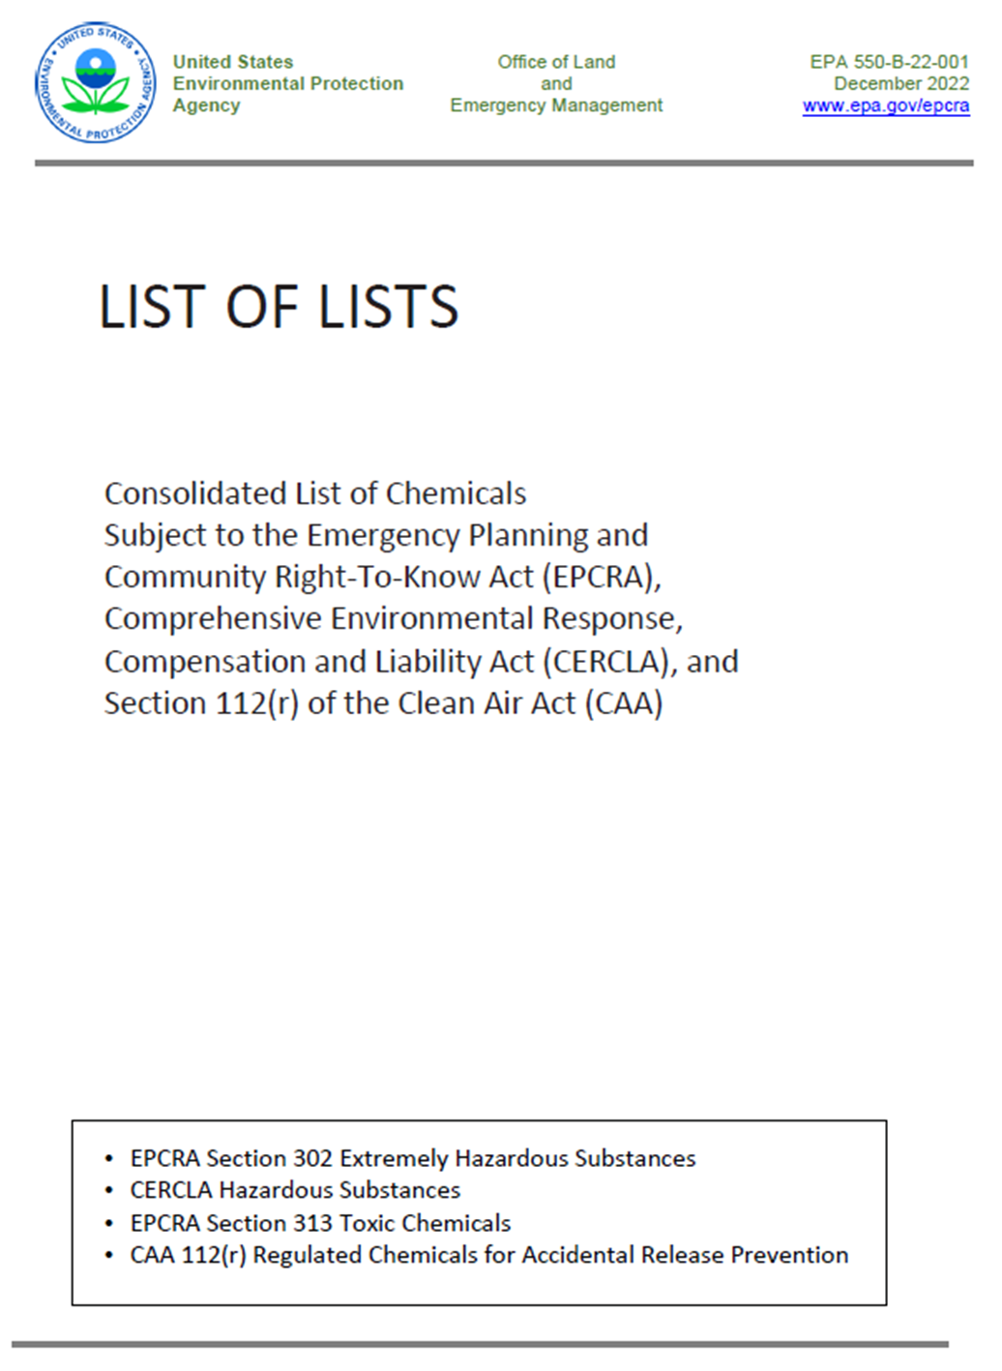
https://www.epa.gov/epcra/consolidated-list-lists
Notes:
EPA publishes a List, commonly referred to as the "List of Lists." Not all chemicals are on this list, but all EHS chemicals are. You can reference this list to find out if your chemical is considered an EHS and find it's reporting threshold. There are currently 360 chemicals that are designated EHS. Commonly reported EHSs in Washington include chlorine, ammonia, and sulfuric acid. Consolidated List of Lists | US EPA https://www.epa.gov/epcra/consolidated-list-lists

Slide 23
EPA’s “List of Lists” How to identify EHS Chemicals under Section 302
TPQ = threshold planning quantity
www.epa.gov/epcra/consolidated-list-lists
www.ecfr.gov/current/title-40/chapter-I/subchapter-J/part-355/appendix-Appendix%20A%20to%20Part%20355
23
Notes:
23
Here's an example of a page from the List of Lists. To find out if your chemical is an EHS, take a look at the column titled "Section 302 (EHS) TPQ." TPQ means threshold planning quantity. If there is a number in this column, it means that chemical is an EHS and the number listed, or 500 pounds – whichever is less, is the threshold amount for Tier Two reporting. It's that simple!
For 302 notifications, use the number listed in this 302 column. In other words, if a business has 1,000 pounds of sulfuric acid, the business must notify their SERC or TERC, LEPC or tribal equivalent, and fire department within 60 days of acquiring the chemical or meeting the threshold. Then, on their annual Tier Two report, they must report quantities greater than 500 pounds.

Slide 24
Exemptions
Solid objects, no exposure
with regular use.
Substances regulated by the FDA.
https://www.epa.gov/epcra/are-there-any-exemptions-under-sections-311-and-312
Notes:
There are a few chemicals or products that are excluded from EPCRA reporting, depending on how they are used.
Substances used in products regulated by the FDA are exempt from reporting. For example, carbon dioxide gas used for carbonation in soft drinks may be exempt. However, carbon dioxide pressurized gas used in other processes would not be exempt.
Solid objects that do not result in exposure during regular use are also exempt.

Slide 25
Additional Exemptions
Used in routine agricultural operations.
Fertilizer for sale to ultimate customer.
https://www.epa.gov/epcra/are-there-any-exemptions-under-sections-311-and-312
Notes:
There is an agricultural exemption for chemicals used in routine agricultural operations, like fertilizer or pesticides applied to crops.
The ammonia contained in fertilizer a farmer uses on crops is exempt. However, anhydrous ammonia contained within pipes used for cold storage is not exempt.

Slide 26
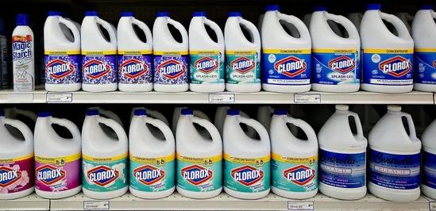
Additional Exemptions
Packaged for distribution and use by general public.
Used in research lab, hospital, or medical facility under direct supervision of a “technically qualified individual.”
https://www.epa.gov/epcra/are-there-any-exemptions-under-sections-311-and-312
Notes:
Chemicals that are packed exactly as they would be sold to the general public are exempt. For example: a one-gallon container of bleach, like Clorox, would not count toward your thresholds, but a bulk storage drum would.
Substances in labs or medical facilities when used under the direct supervision of technically qualified personnel are not subject to reporting requirements. For example, when hospitals use oxygen for patient care, they do not need to report the oxygen. But if there are petroleum products, such as gasoline or diesel, stored on site to power generators, the fuel must be reported if they have more than 10,000 pounds.

Slide 27
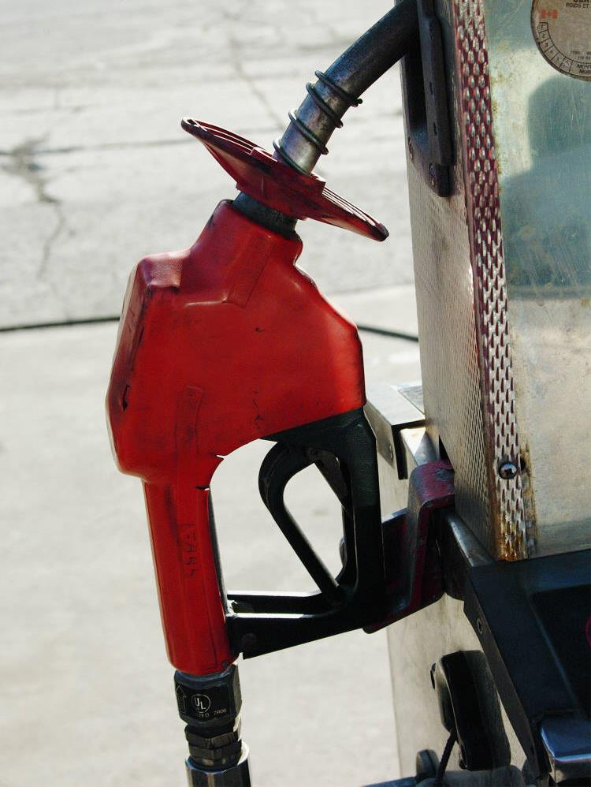
Regulatory relief for fuel stations
Gasoline or diesel at retail fuel stations only.
In compliance with UST regulations.
Less than 75,000 gallons gasoline.
Less than 100,000 gallons diesel fuel.
UST = underground storage tank
www.epa.gov/epcra/eligibility-gasoline-and-diesel-thresholds-retail-gas-stations
Notes:
In 1998, EPA changed the requirements for retail gas stations largely because gas storage locations are clearly marked and visible. This applies ONLY to diesel and gas at retail gas stations.
If your business is a retail gas station AND you are in compliance with underground storage tank regulations AND store less that 75,000 gallons of gasoline (all grades combined) or 100,000 gallons of diesel fuel, these substances do not need to be reported.
However, gas stations may still have to report if they store reportable amounts of other hazardous chemicals such as kerosene or propane.
Gas and diesel at other types of facilities, such as feed stores, tank farms, etc. are still required to report.

Slide 28
Trade Secret exemption requires EPA approval
EPA application process
Must still report generic chemical class or category
https://www.epa.gov/epcra/epcra-trade-secret-forms-and-instructions
Notes:
There is a field on the Tier Two report that asks if the chemical a business is reporting is a trade secret. In order to check this box, the business must apply to the EPA and have their approval granted in order for a business to claim their chemical a trade secret. If this process is followed, the business must still report the generic chemical category and its associated hazards.

Slide 29
Section 304 Emergency Release Notification
A spill or release of EHS must be reported immediately to affected SERC or TERC and LEPC(s) if:
The release meets or exceeds the reportable quantity (RQ) for that substance.
AND
The release could result in exposure to persons outside the boundary of the facility site.
If the chemical is a CERCLA hazardous substance, notification should also go to the National Response Center (NRC).
https://www.epa.gov/epcra/emergency-release-notifications
Notes:
For accidental releases, a business must notify any potentially affected SERC or TERC and LEPCs or tribal equivalents if:
There is a release at the facility of an Extremely Hazardous Substance (EHS) or a Hazardous Substance in excess of the reportable quantity for that substance.
AND
The release could result in exposure of persons outside the boundary of the facility site.
If the chemical is a CERCLA hazardous substance, notification should also go to the National Response Center.
It is important that the emergency release is reported by the facility as soon as everyone is safe, which should be within minutes of the release. You cannot delegate the responsibility for reporting releases to someone else (like the 911 operator). The facility owner or operator is also responsible for providing a written follow up within 30 days.

Slide 30
EPA’s “List of Lists” How to identify spill or release thresholds under Section 304 and CERCLA
https://www.epa.gov/epcra/consolidated-list-lists
Notes:
Consult EPA's List of Lists to find the reporting thresholds under Section 304 of the chemicals your business stores in the event of a spill or accidental release.
Here as example of the 304 column which shows the Reportable Quantity (RQ). If the release also meets the CERCLA RQ, you must also notify the National Response Center (NRC). In this example, an anhydrous ammonia release greater than 100 pounds must be reported to the duty officer and the NRC.

Slide 31
Section 304 Emergency Release Notification
Call SERC—WA State EMD duty officer:
1-800-258-5990
If applicable, call:
NRC 1-800-424-8802
TERC
https://www.epa.gov/epcra/epcra-section-304
Notes:
Here is the contact information for both the duty officer and the NRC.
Call SERC for spills that meet the Section 304 EHS RQ. If the spill is a hazardous substance under CERCLA, also notify the NRC. And if your businesses is on tribal lands, notify the TERC.
It’s always a good idea to go through the steps of an emergency situation for practice. Be sure you know where important emergency contact numbers are located. Keep your LEPC and Fire Department numbers handy and don’t wait for an emergency to make contact with them. Set up a drill!
If there is any doubt about whether reporting is required, make the report. It always the safest way to go.

Slide 32
Section 304 Emergency Release Notification
Written follow-up due within 30 days.
Send to SERC/TERC and LEPC(s).
apps.ecology.wa.gov/publications/summarypages/ ECY070306.html
Notes:
A written follow-up is required within 30 days of the spill or release. Provide updated release description, actions taken to respond to and control the release, and health and safety information.
This form is available on Ecology's website: https://apps.ecology.wa.gov/publications/summarypages/ECY070306.html

Slide 33
No longer need to report?
Below threshold.
No longer have chemical.
Business moved or closed.
Submit an exemption form to the SERC/TERC, LEPC, and fire department.
https://apps.ecology.wa.gov/publications/SummaryPages/ECY070645.html
Notes:
If you find you no longer need to report, please let us know by submitting an exemption form. Once we receive it, we will make your site inactive and you will no longer receive Tier Two reporting reminders from Ecology.
An exemption notification should be submitted if:
Your business no longer stores the materials that were previously reportable.
You still have the chemicals, but the quantities no longer meet the reporting threshold.
You relocated your business.

Slide 34
EPCRA Data for LEPCs and First Responders
Notes:
As mentioned, Ecology manages EPCRA data on behalf of the SERC. There are a number of ways for LEPCs and first responders to get EPCRA data.
Direct request to Ecology. Email diane.fowler@ecy.wa.gov or epcra@ecy.wa.gov to request data for your jurisdiction.
Sign in through E-Plan, a service offered by University of Texas, Dallas. Ecology sends annual Tier Two data to E-Plan and planners and first responders can download Tier Two data for their jurisdiction either in excel format or a CAMEO-compatible format. You will first need to create an account and receive Ecology approval before access is granted to Washington’s Tier Two data.
The EPCRA mobile app developed by the Department of Ecology.

Slide 35
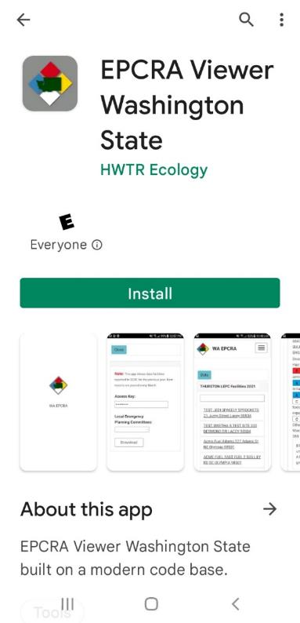
Washington's EPCRA Viewer
Notes:
The Department of Ecology developed a mobile app that allows first responders and regional emergency planners access to Washington’s Tier Two data from a mobile device. The app is available for both Apple and Android devices. To download the EPCRA mobile app, type “EPCRA Viewer” into the search bar and look for the Washington Dept. of Ecology app with the Washington SERC logo.

Slide 36
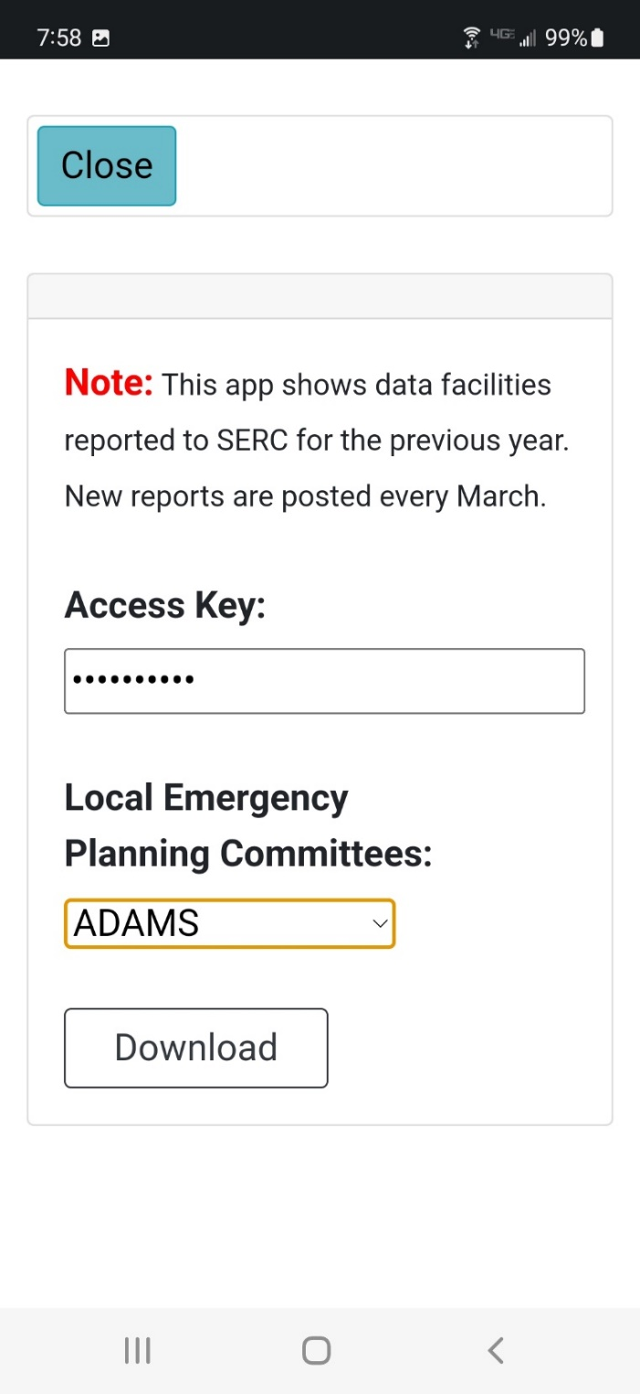
Access Key Required!
Notes:
An access key is required to access the Tier Two data on the mobile app. To request the access key, follow the instructions in the app (email epcra@ecy.wa.gov)
Once you receive your access key, you will be able to download data for your jurisdiction.
I will now turn this presentation over to (Add Name) who will go over Planning.
Optional Facilitator to take 5- minute Break

Slide 37
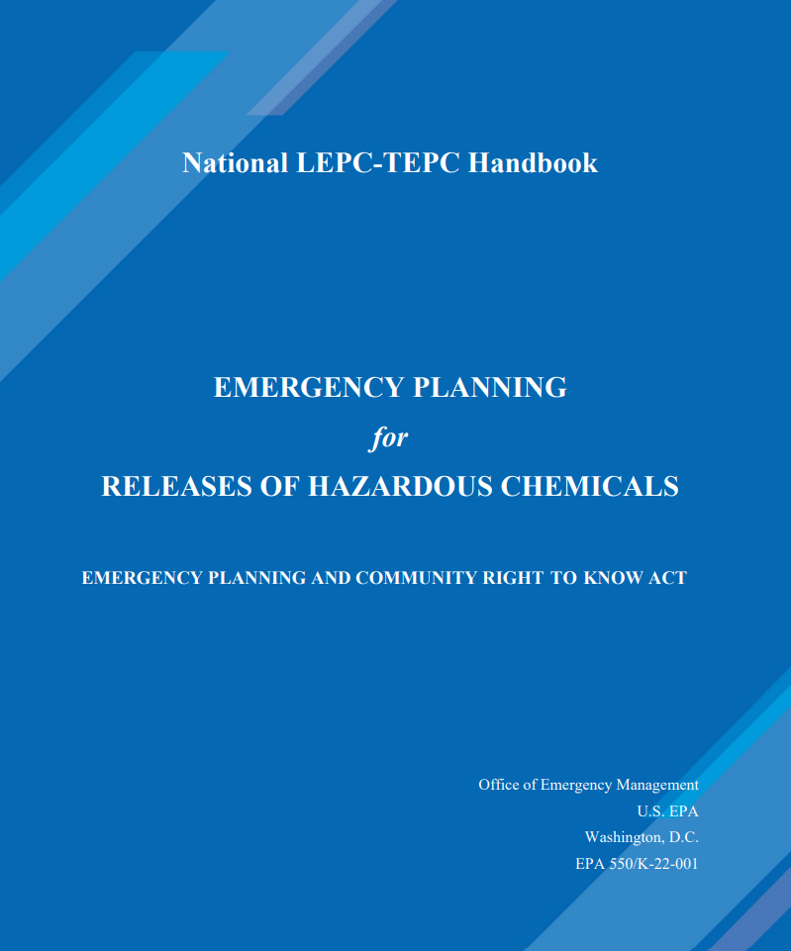
LEPC Planning Process
Notes:
One of an LEPCs or TEPCs most important product is to create and maintain a hazardous material emergency response plan. In this next section, we will discuss how all of you can contribute to your community's plan.

Slide 38
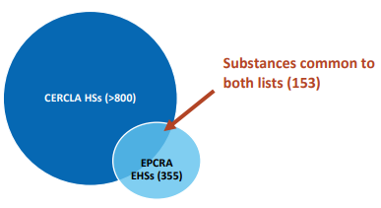
“There are certain provisions in EPCRA that grant authority to LEPCs and TEPCs to obtain information from a facility to assist in local emergency planning (Section 303(d)(3)). If a facility does not provide such information, the SERC or LEPC may take enforcement action, as stated in EPCRA Section 326(a)(2)(B)” -EPA LEPC Handbook
Notes:
Before we dive into planning. It is important to note that if there is a facility in your community that is not a tier two reporter and your LEPC or TEPC would like to incorporate this facility into your planning efforts, you have the authority to ask this facility to provide information for planning purposes. There are certain provisions in EPCRA section 303 that grant authority to LEPCs and TEPCs to obtain information from a facility to assist in local emergency planning. If a facility does not provide such information, the SERC or LEPC may take enforcement action, as stated in EPCRA Section 326 The request for information can be in a form of a letter to the owner or operator of the facility, citing the authority for requesting the information and inform the facility owner or operator that failure to comply with the request is a violation of the law that could result in a penalty.
For example, the graph on this slide represents list of extremely hazardous substances list for EPCRA and the list for Comprehensive Environmental Response, Compensation, and Liability Act (CERCLA). There may facilities that fall under CERCLA but don’t file tier two reports that you LEPC may want to incorporate into planning.
Optional facilitator possible engagement questions to participants:
-What facilities in your community that are not reporting facilities would you want to include in your planning efforts?

Slide 39
Minimum Federal Requirements of an LEPC Plan
(1) Identification of facilities
(2) Methods and procedures to be followed by facility owners and operators
(3) Designation of a community emergency coordinator and facility emergency coordinators.
(4) Procedures providing reliable, effective, and timely notification
(5) Methods for determining the occurrence of a release, and the area or population likely to be affected.
(6) A description of emergency equipment and facilities in the community.
(7) Evacuation plans
(8) Training programs
(9) Methods and schedules for exercising the plan.
Notes:
Listed on this slide are the 9 EPCRA Requirements of a plan. The EPA has provided a checklist of over 77 very specific items needed to meet these requirements. The SERC has provided a plan template and checklist to assist in plan development. After an LEPC is done with their plan they submit it to the SERC. Every year the LEPC should review the plan and the whole plan needs to be updated and resubmitted to the SERC every five years. Please look at this list of requirements and think about the expertise and resources you bring to your LEPC or TEPC. Even if you are not tasked with leading the planning effort, you should review this plan.
Optional facilitator possible engagement questions to participants:
From your perspective, why should you help in the planning process. For example:
If you represent print or broadcast media, you could ensure that the directions provided to meet requirement 7 (evacuation plans) are adequate to inform the public. Or maybe as a first responder, you know facilities that may not be reporting. As a reporting facility, you may have resources available to the county that are not listed in the plan or could provide training that is not incorporated in the training program.

Slide 40
Why do LEPCs create hazardous material plans when State, Regional and National comprehensive and incident specific plans exist?
All disasters are local! Most hazardous material incidents are handled at the local level. County, State, Regional and National resources are only provided If the capacity of the response exceeds the ability of local responders. Even in response requiring a national assets, local emergency managers continue to support the response in their jurisdiction.
All-Hazards Approach: An all-hazards approach is an integrated approach to emergency preparedness planning that focuses on capacities and capabilities that are critical to preparedness for a full spectrum of emergencies or disasters, including internal emergencies and a man-made emergency (or both) or natural disaster.
Notes:
SERC support staff are often asked why do LEPC's need their own hazardous material plan because we have a comprehensive regional Northwest Area plan or because some communities lack resources and depend on support from neighboring jurisdictions or the Department of Ecology. The answer simply is that all disasters start and end locally. Local emergency managers will be first on scene and will need to know how to respond. This is why it's so important for every LEPC or TEPC, even ones with limited resources, to think about the hazardous material risk in their community and what they can do to bridge the gaps in the resources.

Slide 41
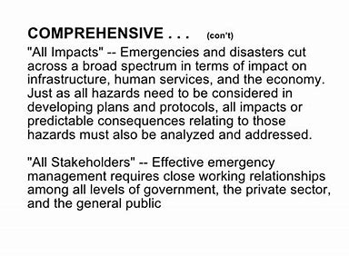
Comprehensive Emergency Management plans and the Northwest Area Contingency Plan
State CEMP
Local CEMP
NWACP
ESF 10
ESF 10
LEPC
Plans
Notes:
LEPC Plans need to nest within local Comprehensive Emergency Management Plans, the State Comprehensive Emergency Management Plan, and the Regional Northwest Area Contingency Plan. If you are not a LEPC Community Coordinator writing a plan may sound daunting. However, you have Emergency Management personnel that will help walk your LEPC through the process. Your role is to contribute your knowledge and experience. After a plan is created and approved by your LEPC, be sure to review annually to look for updates or changes.
Reminder to facilitator to ask participants if they have questions:
Now for our next Section, (Add Name) cover exercises.

Slide 42
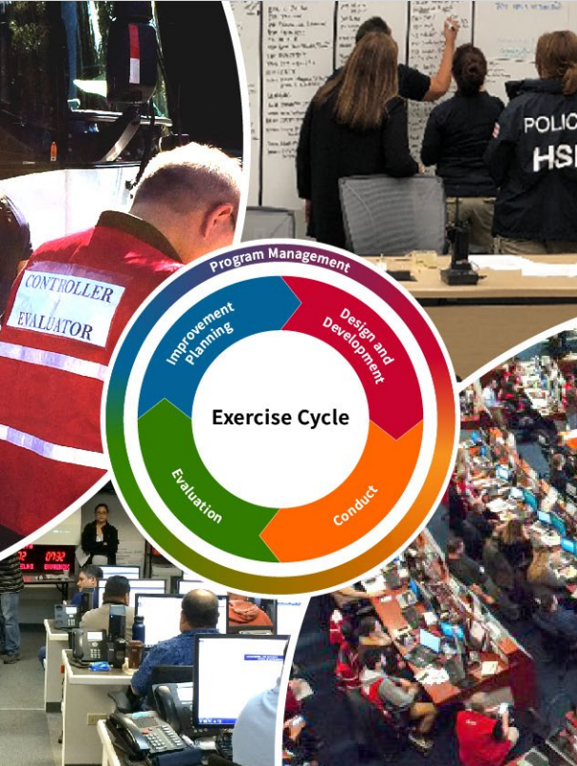
LEPC Exercise
42
Notes:
LEPCs are required by EPCRA to exercise their LEPC plan regularly. It is recommended that LEPCs have annual exercises. Exercises are an opportunity to provides a low-risk environment to familiarize personnel with roles and responsibilities; fosters meaningful interaction and communication; identifies strengths and areas for improvement.

Slide 43
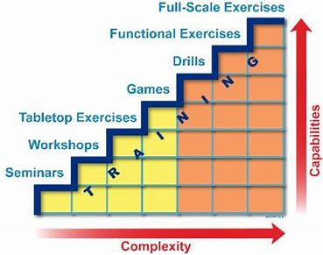
LEPC/TEPC Exercise
Notes:
The graphic on this slide shows the increasing complexity of different types of exercises. It is tempting with a new plan to jump into a full-scale exercise; however, we recommend you take a progressive approach. A multi-year exercise program enables jurisdictions/organizations to participate in a series of increasingly complex exercises, with each exercise building upon the previous one. Starting with a seminar to share information or a discussion-based workshop and moving up to a complex Full-Scale Exercise involving multiple agencies, jurisdictions/organizations, and real-time movement of resources.
Reminder: when planning an exercise, you don’t need to “test” or “exercise” the entire plan.

Slide 44
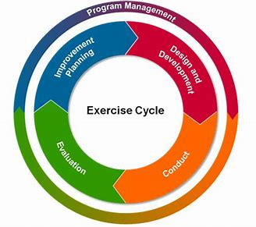
LEPC/TEPC Exercise
https://preptoolkit.fema.gov/web/guest/welcome
Notes:
The Integrated Preparedness Cycle of planning, equipping, training, exercising, and evaluating and improving is a continuous process that ensures the regular examination of ever-changing threats, hazards, and risks. The Cycle involves the assessment of threats, hazards, and risks; new and updated plans; and improvements implemented from previously identified shortfalls or gaps. This cycle provides a continual and reliable approach to support decision making, resource allocation, and measure progress toward building, sustaining, and delivering capabilities based on a jurisdiction’s/organization’s threats, hazards, and risks. As a member understanding the process and involving your perspective and organization is essential to your LEPC or TEPC.
The Preparedness Toolkit Link (PrepToolkit) is an online collaborative environment which individuals from all levels of government and the private and nonprofit sectors can utilize to prepare for risks in their communities. Some of the many tools it provides is access to exercises and the Homeland Security Exercise and Evaluation Program (HSEEP) guidance and forms. You will be required to create an account. The PrepToolkit is designed for use by the whole community.
Working with other agencies in the community to link to their exercises is another way share resources and exercise the LEPC plan without having to create a ‘stand alone’ exercise. For example, if your community health department or hospital is having a mass casualty exercise, perhaps you could link it to a hazmat release. Or, if your law enforcement or fire agencies or emergency management office wants to exercise an evacuation plan, that could be tied to your LEPC plan as well.
Optional facilitator possible engagement questions to participants:
- Do any of our participants today have an example of an exercise best practice or an exercise example that worked well for your community?
I will now turn this presentation over to (Add Name) who will cover the training section.

Slide 45
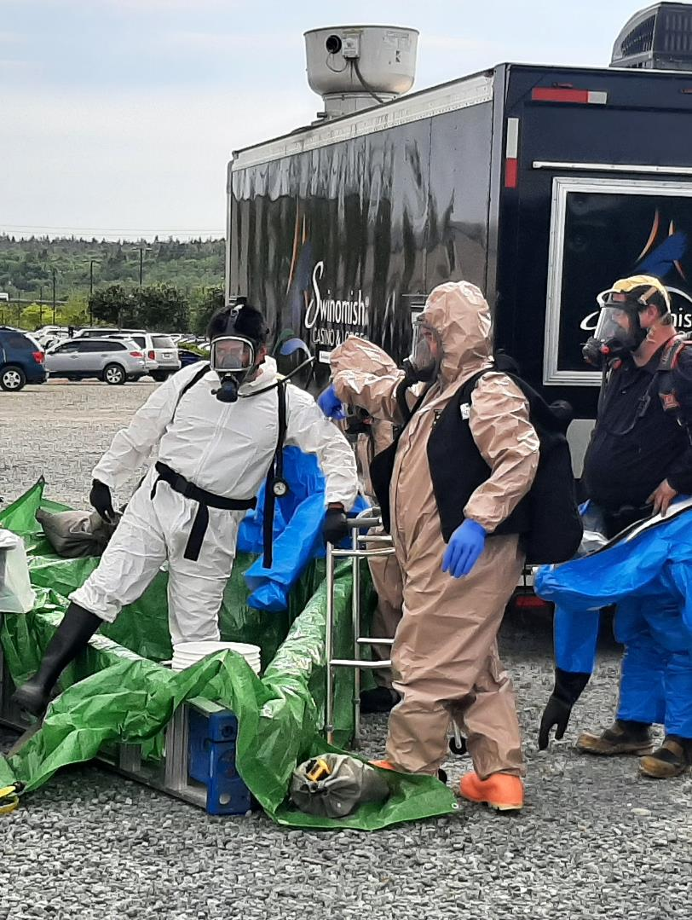
LEPC/TEPC Training Programs
45
Notes:
LEPCs are Required by EPCRA to have a Training Program. Since EPCRA was implemented in 1986, emergency management practices have evolved. Now LEPCs in Washington should participate in the All-Hazards training at the local, state and federal level. LEPC should contribute to assessments with Local emergency management to help define the risk and training gaps in the community. Please remember to document all the training provided by your committee.
An LEPC Training Program should be referenced in their plan. This plan should include a training schedule. We encourage your LEPC’s to provide a link to your local jurisdiction's emergency Management Training Schedule, the Washington State Patrol Hazardous Material Training Schedule and the EMD Training Calendar. Also, Training does not always need to be a formal class. It can also be presentations and information shared at meetings.

Slide 46
Emergency management training coordinated through the Washington State Military Department Emergency Management Division
WA EMD (learningstream.com)
Notes:
The image on this slide is the SERC page on the state training calendar. This calendar is also linked to the training provided by the Division of Emergency Management. A list of additional training resources is available in the LEPC Toolbox.
Reminder to facilitator to ask participants if they have questions:

Slide 47
SERC Recommended LEPC Member Training
ICS 100 200 700 800 FEMA Training
IS-120.C: An Introduction to Exercises IS-120.C
EPA EPCRA Training
IS-5.A: An Introduction to Hazardous Materials IS-5.A
Washington State Open Public Meeting Training (add link)
As you grow as a LEPC Member, we recommend you also take:
ICS 300 400 WA EMD (learningstream.com)
L0146 Homeland Security Exercise and Evaluation Program (HSEEP) WA EMD (learningstream.com)
Other Training recommended by your LEPC Community Coordinator
Please note that the recommended training to be an LEPC member does not supersede or replace training you need for your Occupation!
Notes:
As an LEPC Member, the SERC Support Staff recommends you take the following courses listed on this slide. Your LEPC may recommend additional training. Please document and track your own training.
-Incident Command System training is essential for anyone who will be involved in any incident. ICS 100, 200, 700 and 800 are available online and ICS 300 and 400 are in person courses.
-All LEPC Member should be familiar with exercises and the IS-120.c Course is free and available online. The Homeland Security Exercise and evaluation Program is a great resource for anyone who develops exercises.
-EPA offers an online self paced EPCRA course. It is good information, but we recommend you take the training in steps because its approximately 12 hours long.
-For anyone new in the world of hazardous materials, the Introduction to Hazardous Materials offer online by FEMA is a great course. It is free and online.
-Last but not least, Washington State Open Public Meeting Training is a 19-minute online video.

Slide 48
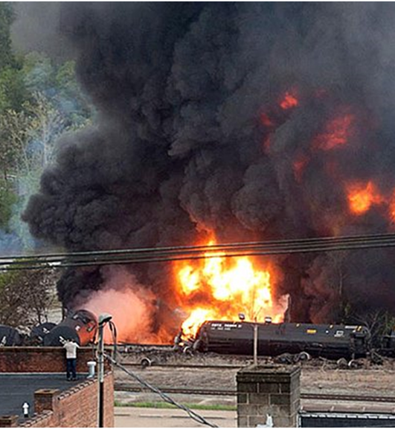
WSP Hazardous Materials Training
Free Training for First responders
Grant Funded Training
HMEP and EMPG grant funding
PHMSA and FEMA
48
Notes:
Let’s take a few minutes and talk about the Washington State Patrol (WSP) Hazardous Materials Training Program. The WSP offers free training to 1st responders. This includes anybody that is involved with either planning or responding to a hazardous materials event as well as recovery, fire, law enforcement, EMS, Emergency Management, and healthcare. Our training is grant funded. The Hazardous Material Emergency Preparedness (HMEP) grant provided by the Pipeline and Hazardous Materials Safety Administration (PHMSA) Grant requires that the training we provide through HMEP is related to road, rail pipeline, marine and aircraft. The funds provided by the FEMA Emergency Management Performance Grant (EMPG) is a little bit more open minded. This grant allows us to provide the responders with some things outside of the transportation mode. Overall, we train roughly about 1700 people a year and that number includes the State Patrol to keep them up to date with their hazmat skills.

Slide 49
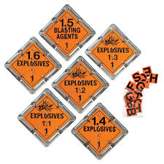
Training Courses
HM Awareness
HM Operations
HM-Technician
HM-On Scene Incident Command
HM-IQ
Hazmat Safety Officer
Notes:
The training Courses on this slide are referred to by the WSP as the legacy training courses. All of these courses comply with OSHA 1910.120 and with NFPA 470 as well as the Washington Administrative Code (WAC) on training requirements for employees. Please be aware that the OSHA 1910.120 and WAC are somewhat dated and the number of hours that you may see within regulations are less than the hours for current courses. The WSP exceeds training hours in some cases by quite a bit because from the time that those regulations were created in the late 70s, early 80s the HAZMAT world has really developed and there are a few more hazards that didn’t exist or were not recognized.
The Awareness, Operations, and Technician level training is a crawl, walk, run, situation.
Awareness level is intended for anybody that may witness a hazmat event so they will be able to identify what's involved, keep people isolated and make the necessary notifications. Awareness level personnel typically don't have the PPE or the protective personal equipment or respiratory protection to do much else.
Operations level is a defensive measure where they can do damning, diverting, diking, putting down absorbent pads, things of that nature to limit the spread of a spill. Operations level can also do some basic detection.
The Technician level in the state of Washington is a 40-hour class. It covers everything from regulations to practical exercises, and proper PPE for different levels of hazmat response. Decontamination, also referred to as Decon, is covered in both operations and technician level courses.
The Hazmat On Scene Command is an important class. Many agencies use this course for a promotional standpoint where the individual must take this class to get promoted to Battalion Chief or to a mid-level leadership role. All WSP sergeants must take this class. This course is particularly useful for WSP employees because the WAC requires the State Patrol to serve as an Incident Commander in the Incident Command Structure for designated jurisdictions. The WSP will typically respond in a Unified Command Structure. It is important to note that the WSP does not have a HAZMAT team, so they will not fly in and helicopter and repel down and mitigate the situation, but they will serve as the Incident Commander for the local jurisdictions that have designated WSP for that role.
The HAZMAT IQ and safety officer are specialty courses. The WSP also has a Hazmat chemistry class, which is not included on this slide. It is typically 40 hours, and it's pretty intense and students gain a better understanding of the chemistry of hazardous materials.

Slide 50
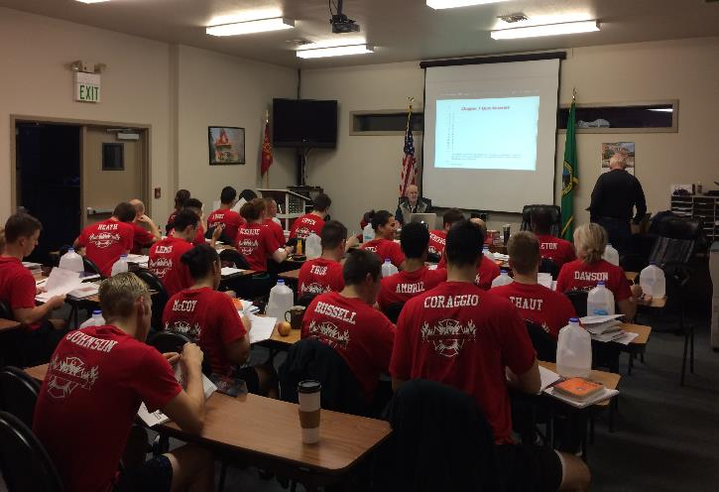
Why Do We Need To Train?
WAC 296-824-30005 Train Your Employees
29 CFR 1910.120 Hazardous Waste and Emergency Response
NFPA 470 Hazardous Materials/WMD Standard for Responders
Notes:
So, what training do we need? Do you need to do this training well? Here are the are the regulations and the standards we spoke about earlier.
WAC 296-824-30005 Train Your Employees
29 CFR 1910.120 Hazardous Waste and Emergency Response
NFPA 470 Hazardous Materials/WMD Standard for Responders
(Add Name) will cover measuring success in the last section.

Slide 51
Measuring Success
Notes:
Success is specifically relevant to the community the LEPC serves. Your LEPC may be evaluated by local government entities, the mayor, the city council, or a similar group. Industry may want to know if the chemical information they provide is being used wisely and efficiently. Individual citizens may wonder if your work is effectively protecting them. Federal agencies may use indicators of success to support grant funding and other decisions related to LEPCs/TEPCs. And, of course, you, as LEPC members may want to study what you are doing to see if you are satisfied with your work and whether your efforts have lead to better protection of the community from chemical risks. All these and other issues can provide the reasoning to measure the progress of your LEPC. It is important that each LEPCs/TEPCs to have their own vision of success based upon the risks, capacities, and conditions in the community they serve. That vision should be written, clear, and come from a group discussion of the concerns, conditions, and readiness of the community and jurisdictions that the LEPC/TEPC serves. It may be that there is a belief that the vision is difficult to obtain given current resources. That does not matter as long as the LEPC understands its mission is to make progress towards the vision. The vision of success is an aspirational goal and should set the long-term objectives for the work done by the LEPC.
We highly encourage each LEPC to create a strategic plan or a set of achievable goals for continuous improvement. There is an example of this in the LEPC toolbox to help get things rolling. As with any endeavor, creating momentum is important for success.

Slide 52
How to Energize your LEPC/TEPC
Keep your LEPC/TEPC Active
Incorporate a Strategic Plan
Facility Field Trips & Involved Industry
Informational Speakers/Facility Presentations
Fire/LEPC Meetings for Business Community
Recognize and reward good partners
Incorporate a meal or snacks
Increase the Capabilities of your LEPC/TEPC
Incorporate a non-profit Know the RISKS & CAPABILITIES in your community
Conduct a LEPC/ TEPC Self Evaluation Checklist
Targeted Training and Exercises
Integrate with Water treatment and other facilities
Visual Representation of Hazards and vulnerabilities
Educate Public & Businesses
Safety Fair Activities
Targeted Meetings
Include community groups
LEPC Website / Printed Materials
Notes:
While Community Coordinators are an essential parts of your organizations, Truly successful LEPCS or TEPCs utilize the expertise and resources of their entire membership to be successful. On this slide we have a few things you can do to contribute to the success of your LEPC.
For example:
If you represent a facility, you could invite the LEPC over for a tour.
Private Sector partners often have a little bit more resources available and could offer a luncheon or snacks.
First Responders can incorporate the LEPC into their Community Meeting and events.
An elected official may want to encourage their LEPC to conduct the LEPC/ TEPC Self Evaluation Checklist together.
Health care representative may want to invite their LEPC TEPC to an exercise.
Representatives from Print or Broadcast media could contribute their expertise to the information provided online or in printed materials for the public.
Optional facilitator possible engagement questions to participants:
What other thoughts do you have on how you can contribute to the success of your LEPC or TEPC?

Slide 53
LEPC Resources
EPA LEPC Handbook
National LEPC-TEPC Handbook | US EPA
EPA Emergency Planning and Community Right-to-Know Act page
Emergency Planning and Community Right-to-Know Act (EPCRA) | US EPA
SERC Websites
EMD: State Emergency Response Commission (SERC) | Washington State Military Department, Citizens Serving Citizens with Pride & Tradition
ECY: State Emergency Response Commission - Washington State Department of Ecology
Notes:
There are countless resources available to LEPC and TEPC's to improve their organizations here's just a short list of a few to start with if you need additional resources, please reach out to SERC support staff.

Slide 54
If you have questions, please reach out to SERC support staff:
Scott Lancaster
Deputy State Fire Marshal
Washington State Patrol/State Fire Marshal’s Office
scott.lancaster@wsp.wa.gov
Diane Fowler
Emergency Planning & Community Right-to-Know Reporting
WA State Department of Ecology
EPCRA@ecy.wa.gov
Susan Forsythe
Washington State SERC Coordinator
Emergency Management Division
Washington Military Department
susan.forsythe@mil.wa.gov
Eastside EMD Field Rep: Pete Hartmann
Phone: (509) 435-6288
peter.hartmann@mil.wa.gov
Central EMD Field Rep: Stephanie Hakala
Phone: (253)298-5446
stephanie.hakala@mil.wa.gov
Northwest EMD Field Rep : David Kelley
Phone: 253-325-3451
david.kelley@mil.wa.gov
Southwest Field Rep: Chris Caprio
Phone: (253) 357-2874
christopher.caprio@mil.wa.gov
54
Notes:
As we finish up our presentation today, we would like to point out the SERC has support staff that can also be a resources to your LEPC.
Reminder to facilitator to ask participants if they have questions:

